Slide 1
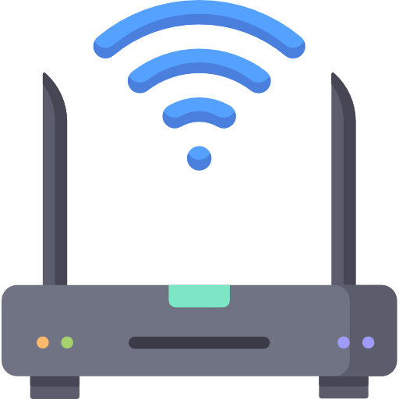


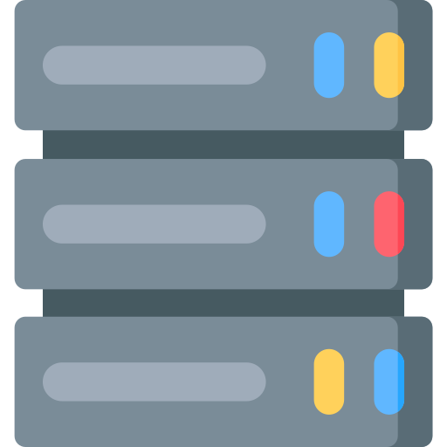

Doorbell Responds with the specific requested commands
If the Wifi is supplied with internet facility doorbell must establish a communication with Mobile
Request reaches the Wifi network of the specific Doorbell based on the Unique ID and IP details stored during the configuration of Doorbell(Need to confirm whether IP requires to establish the communication with router)
Response must reach the mobile over an internet
Content
Unique ID+Username+Password
Servers helps in establishing the communication
Unique IDs for all the Doorbells will be stored in DB

